Slide 1
Agile business analysis Sprint 3
Sidra, David, Laura & Soyhan

Slide 2
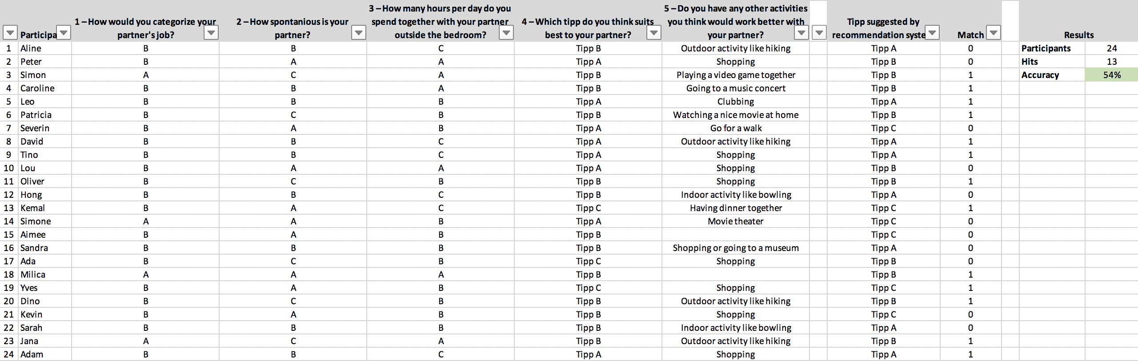
Overall Recommendation Concept
Participants: 24
Hits: 13
Accuracy: 54%

Slide 3
Performance – Tipp A
Tipp: Surprise your partner with an invitation to the movies
Number of Recommendations: 8
Number of Hits: 4
Proposed Alternative: Tipp B (100%)
Accuracy: 50%
Conditions: N = 24, Period = 02.12.2019 – 13.12.2019, Audience = Target Segment Only

Slide 4
Performance – Tipp B
Tipp: Ask your partner to choose an activity of choice to do on the next free evening (options: board game, watch a movie, go out dancing)
Number of Recommendations: 10
Number of Hits: 7
Proposed Alternative: Tipp A (67%) / Tipp C (33%)
Accuracy: 70%
Conditions: N = 24, Period = 02.12.2019 – 13.12.2019, Audience = Target Segment Only

Slide 5
Performance – Tipp C
Tipp: Invite your partner to a fancy dinner in a nice restaurant you have never been before
Number of Recommendations: 6
Number of Hits: 2
Proposed Alternative: Tipp B (75%) / Tipp A (25%)
Accuracy: 33%
Conditions: N = 24, Period = 02.12.2019 – 13.12.2019, Audience = Target Segment Only

Slide 6
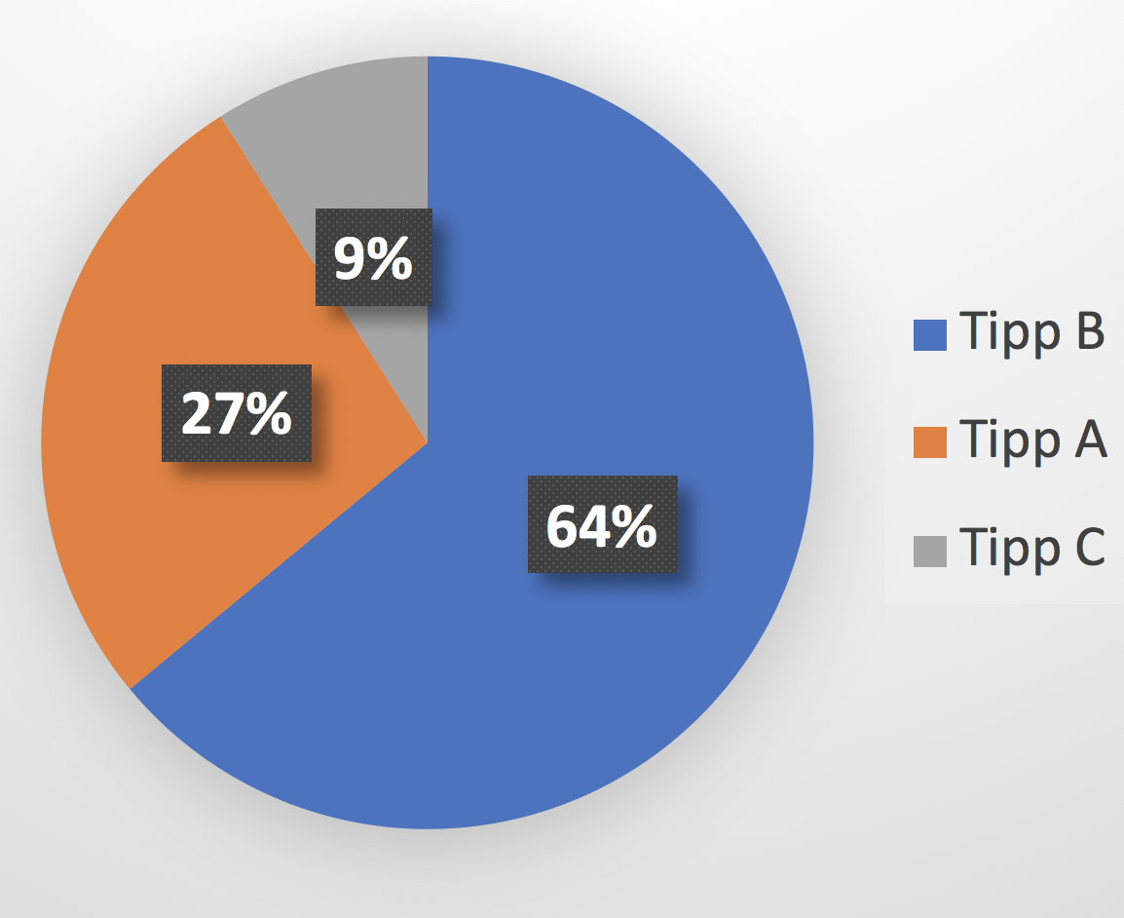
Overall Negatives
Number of Negatives: 11
Proposed Alternative:
Conditions: N = 24, Period = 02.12.2019 – 13.12.2019, Audience = Target Segment Only

Slide 7
Identified correlations
IF | THEN | PROBABILITY
Recommendation = false Question 1 = B Question 2 = B Question 3 = A, B, C | Tipp = B | 72%
Recommendation = false Question 1 = B Question 2 = A Question 3 = A, B, C | Tipp = A | 80%
Conditions: N = 24, Period = 02.12.2019 – 13.12.2019, Audience = Target Segment Only

Slide 8
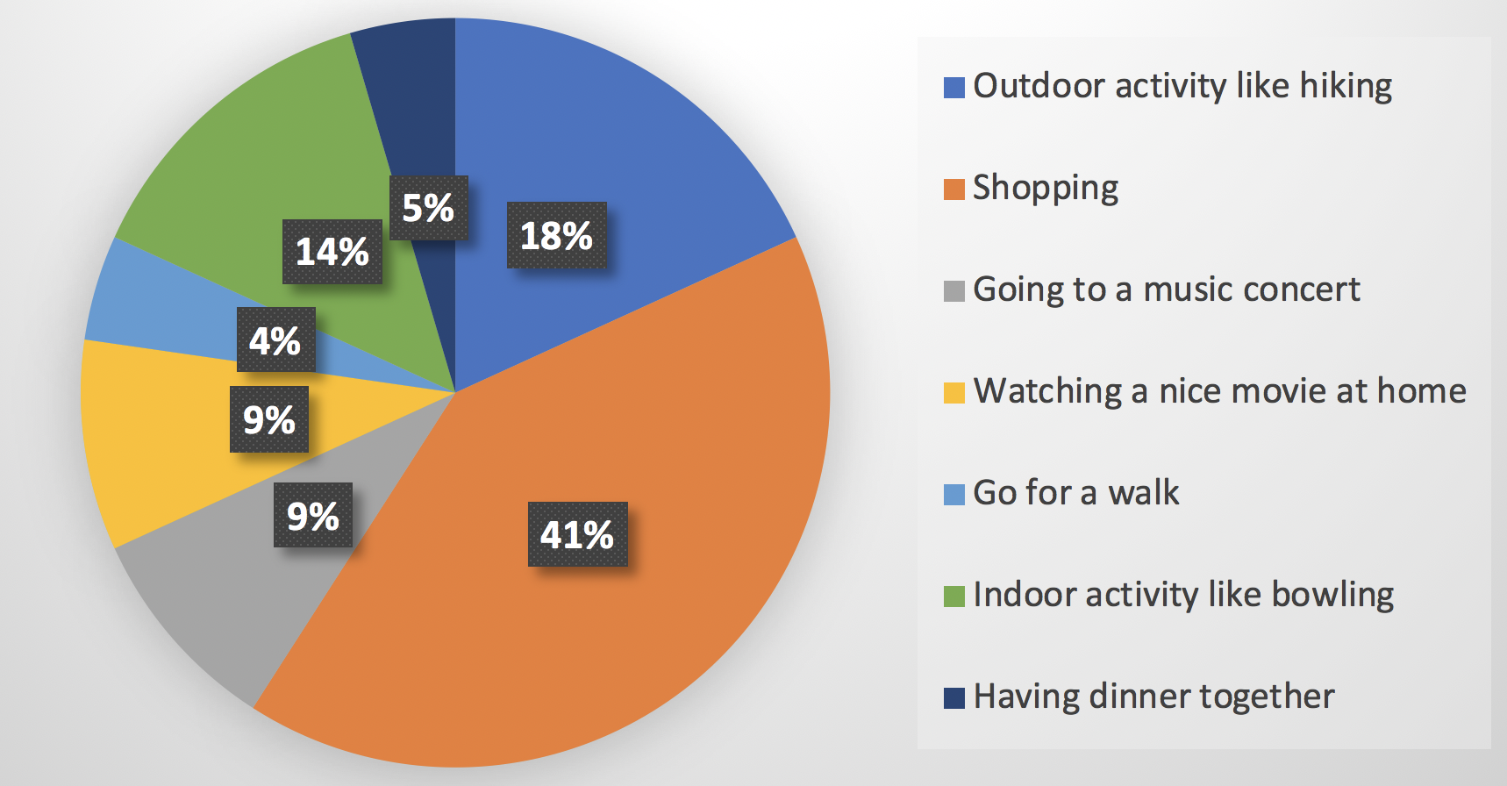
Other Suggested Alternatives
Conditions: N = 24, Period = 02.12.2019 – 13.12.2019, Audience = Target Segment Only

